Slide 1


^{New Talent Alliance}
An Employer’s Introduction to Apprenticeships
^{Tuesday 11th November 2025}
Notes:
Good afternoon and a big warm welcome to you all.
Thank you for attending this webinar today titled “An Employer’s Introduction to Apprenticeships”.
I’m Tom Hegarty, CEO of Simplybiz and Chair of the New Talent Alliance and I’ll be introducing the session today.
In addition to my role at Simplybiz and the work I do at the New Talent Alliance, I’m also Chair of the Trailblazer Group for Apprenticeships within the financial advice sector, so an area which I have some good expertise on and am passionate about this as a route to support more career journeys in our sector.

Slide 2

The Apprentice
Notes:
When mentioning the term Apprenticeships, many might think of the general definition of apprenticeships or even of Alan Sugar on the BBC. Or even Donald Trump for that matter who ran the US version of the Apprentice.
According to the dictionary, an Apprentice is a person who is learning a trade from a skilled employer, having agreed to work for a fixed period at low wages.
However, my terminology of Apprenticeships is very much to do with the Government initiative, which they developed significantly from around 2015 and created funding around this too.
The Government made a concerted effort to offer the option of Apprenticeships as an alternative to other forms of further education, which effectively combined work and study together to give people an opportunity to move forward with their professional development and career plans.
In the past, apprenticeships have been very focused on trades, but more recently they have widened in scope significantly to include more professional career paths where qualifications go up to degree level and beyond.

Slide 3
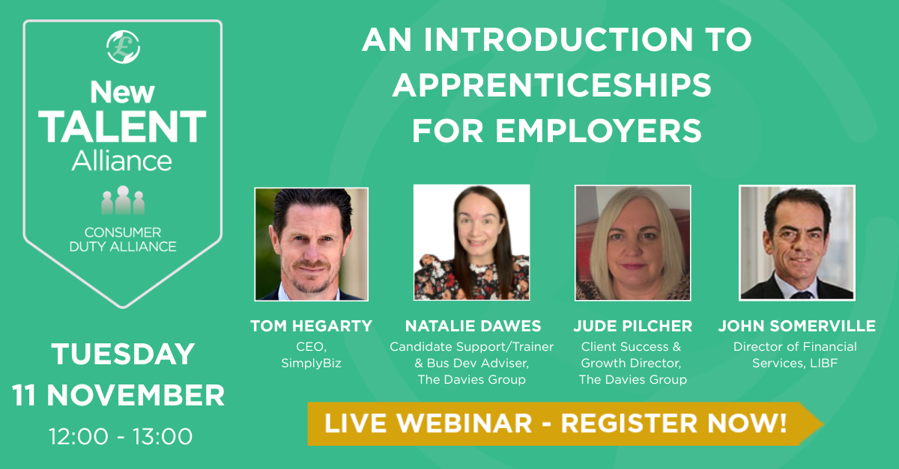
Introductions
Notes:
Over the next hour, we will be looking to provide you with An Introduction to Apprenticeships for Employers.
And I’m delighted to be joined by:
Natalie Dawes who is a Candidate Support/Trainer and Business Development Adviser at The Davies Group
Jude Pilcher who is Client Success & Growth Director at The Davies Group
And, John Somerville who is Director of Financial Services at the LIBF
This webinar today will outline some of the basics around what apprenticeships are, how they work and why they are important with the financial advice sector.

Slide 4
Learning Objectives
Understand the strategy of the New Talent Alliance, and why we need to help firms recruit, train, develop, manage and retain talent in their business.
Explore the basic mechanics of Apprenticeships in England and how they are funded.
Learn about some specific updates recently made to Apprenticeships, especially in Financial Advice and Paraplanning.
Explore how Apprenticeships could be used as a training and development pathway for new and existing talent.
Notes:
Here are the learning objectives we have for this webinar today:
Understand the strategy of the New Talent Alliance, and why we need to help firms recruit, train, develop, manage and retain talent in their business.
Explore the basic mechanics of Apprenticeships in England and how they are funded.
Learn about some specific updates recently made to Apprenticeships, especially in Financial Advice and Paraplanning.
Explore how Apprenticeships could be used as a training and development pathway for new and existing talent.

Slide 5
Introduction to the New Talent Alliance
^{Tom Hegarty}
Notes:
However, before we move on to these details around Apprenticeships, I wanted to firstly give you a very brief introduction to The New Talent Alliance and what we are aiming to do.

Slide 6



New Talent Alliance
A Sector Collaboration
Engage
Engage with all stakeholders across the sector to raise awareness of the NTA initiative and help promote careers in advice to new talent.
Inspire
Inspire and encourage advice firms to recruit and develop new talent by overcoming concerns and outlining the benefits and support available.
Support
Support firms with attracting and recruiting; training and developing; and managing and retaining new talent through good practice.
Notes:
The New Talent Alliance was founded in March 2024, as a working group within the wider Consumer Duty Alliance to help firms recruit, train, develop, manage and retain talent in their business, which will support business growth and succession planning particularly within small and medium sized firms.
We’ve created a strategy which is threefold: Engage, Inspire and Support.
Engage – All Stakeholders to raise awareness of the NTA initiative and help promote careers in advice to new talent through elevating the value of advice and being seen as an attractive profession of choice.
Inspire – Potential Employers to recruit and develop new talent within their businesses. Whether they are looking to grow their businesses or create a succession plan, we need to encourage employers to see the benefits in bringing new talent into their firms.
Support – All firms keen to recruit new talent on how to do this, by providing toolkits, guidance and good practice on how to attract, recruit, train, develop, manage and retain new talent for their businesses.

Slide 7
Shifting Demographics
Number of firms in the UK authorised to provide retail investment advice:
Date | August 2022 | February 2024 | February 2025 | % Change
Firms | 6,240 | 5,805 | 5,473 | -12%
Number of individuals in the UK authorised to provide retail investment advice by age range:
Age Range | August 2022 | February 2024 | February 2025 | % Change
Under 25 | 426 | 174 | 254 | -40%
25 – 29 | 1,989 | 1,641 | 2,076 | +4%
30 – 39 | 5,668 | 5,758 | 7,367 | +30%
40 – 49 | 8,200 | 7,622 | 8,878 | +8%
50 – 59 | 10,037 | 9,777 | 10,370 | +3%
Over 60 | 4,824 | 6,210 | 6,797 | +41%
TOTAL | 31,144 | 31,182 | 35,742 | +15%
Source: FCA – FOI Request (February 2025)
Notes:
The main area that the NTA is trying to support is by helping to address the changing demographics within the supply chain of the advice sector.
As you can see from the data here over 3 time periods from August 2022 to February 2025, which is a two-and-a-half-year period, the number of firms in the UK retain investment advice sector has reduced by 12% and the number of advisers has increased by 15%.
The hypothesis here overall is that the larger firms in the sector are consolidating the smaller firms and in addition, they are also producing the lions share of new advisers to the sector through their Academies.
The increase in adviser numbers is positive, but in addition to the advice gap, there is a polarisation shift where these larger firms are getting bigger and smaller firms are diminishing.
This is therefore limiting choice to the consumer for their options to support their advice needs.
Within the NTA, we are supportive of all firms offering advice, but it is important that we support the continuation of a diverse and competitive advice sector and ensure that all firms have the ability to recruit, train, develop and manage new talent and not just the large firms. We therefore want to share the expertise to smaller firms who have less experience, funding or knowledge to grow their businesses with new talent.

Slide 8
^{The Mechanics}
How Apprenticeships work and how they are funded
Notes:
I’m now going to hand over to John Somerville to go through some of the mechanics of how Apprenticeships work and how they could provide a solution to this conundrum.

Slide 9




Apprenticeships
Who is eligible?
Available 16+
Living in England
Not in full-time Education

Slide 10

Apprenticeships
What are the benefits?
Earn as an Employee
Gain Qualifications
Develop Skills

Slide 11

Apprenticeships
How do they work?
80%
Of the Apprentice’s time is spent in the workplace,
20%
Of the Apprentice’s time is spent learning knowledge, skill and behavioural competencies
Employer
The employer will deliver the on-the-job training
Training Provider
The training provider will deliver the off-the-job learning

Slide 12
Apprenticeships
Some Statistics
Over 800
Different Apprenticeship Standards currently available in England. (Devolved Policy)
736,530
People participating in an apprenticeship in England in academic year 23/24
48%
Of the apprenticeships started in 23/24 were people over 25 years old
79%
Of apprenticeships started in 23/24 were at advanced or higher level
Notes:
Changed “Over 700” to “Over 800” as there are currently 836 apprenticeship standards available
Changed 752,150 in 22/23 to 736,530 in 2023/24
The percentage of over 25’s remains at 48.4%
Changed 77% to 79%

Slide 13
Apprenticeships
Apprenticeship Standards
Level
Intermediate – Level 2
Advanced – Level 3
Higher – Levels 4,5,6,7
Degree – Levels 6,7
Duration
Anywhere between 8 months and 5 years to complete depending upon level
Funding Band
There are 30 different funding bands, ranging from £1,500 to £27,000
Notes:
Duration – changed 1 year to 8 months in line with the latest minimum duration guidelines changed in 2025

Slide 14
Apprenticeships
Parties involved in Apprenticeships
Apprentice
Attending all OTJ training and recording the hours
Engaging in the apprenticeship and completing all training
Having regular progress reviews with employer and training provider
Employer
Contributing to the training plan
Pay co-investment towards apprenticeship
Coach, mentor and support the apprentice’s learning needs
Giving the apprentice time to complete their OTJ training
Training Provider
Discussing the training plan with the employer
Delivering the OTJ training to the apprentice
Preparing the apprentice for their end-point-assessment
End Point Assessment Organization
Creating an assessment plan for the apprentice
Independently conduct the assessment at the end of the apprenticeship
Notes:
Employer – “pay co-investment towards apprenticeship” may be worth mentioning that Levy payers do not pay co-investment, SME’s do not pay co-investment if the apprentice is under 22 years of age at the start of the programme. Co-investment for those that do pay it is 5% of the total negotiated funding, divided by the duration and then taken monthly from the digital account.

Slide 15

Apprenticeship Funding
The Apprenticeship Levy…
Apprenticeship Funding
From April 2017, Apprenticeships are funded by a levy on UK businesses with a salary role of over £3M
This uses a Digital accounting system for collecting the levy and paying Training Providers
Levy-Paying Employers
All UK businesses with a payroll of over £3m per year
Pay 0.5% of payroll into “Levy Pot” monthly
Can utilise “Levy Pot” to pay for Apprenticeship Training within their own organization
Unused levy money will expire after 2 years and can be then used by Government
Non-Levy-Paying Employers
All UK businesses with a payroll under £3m per year
Do not need to pay towards the Apprenticeship Levy
Can still utilise Apprenticeship Funding through Co-Investment
Employer pays 5% of training costs and Government pays 95%
Notes:
As per last slide – non-levy payers with an apprentice under the age of 22 at the start do not pay co-investment.
Also of note is that employers do not pay class 1 national insurance for apprentices under the age of 25 who earn less than £50,270 per year – significant cost saving

Slide 16
Level 4 Paraplanner and Financial Planner Apprenticeship Standard

Slide 17
Paraplanner & Financial Planner Standard
Level | Duration | Funding Band
Higher (Level 4) | 24 Months plus 5-month End Point Assessment | £13,000
Knowledge, Skill and Behavioural Competencies
Knowledge | Skills | Behaviours
Financial services market providers, tech, support Advice ethics, models, and regulatory framework Client protection: systems, standards, and relationships Responsible investing and product research Understanding client needs, goals, and risk Data analysis, security, and planning tools Communication strategies for diverse audiences Performance analysis and inclusion principles Focus on paraplanner and financial planner knowledge: creating compliant documents, validating research, meeting standards, handling objections, exploring sustainable investing, and maintaining adviser competence. | Use digital tools securely in line with cyber and data protection Deliver client services aligned with Consumer Duty and TCF Prepare compliant financial recommendations and advice Meet service and quality assurance standards Communicate effectively across formats and audiences Interpret financial data for diverse stakeholders Build collaborative relationships to support client outcomes Reflect on feedback and pursue continuous professional development Paraplanners focus on research, analysis, and tailored reporting; financial planners lead client engagement, assess needs and risk, and deliver advice aligned with ethical and regulatory standards. | Acts with professionalism, ethics, and integrity Pursues learning and continuous professional development (CPD) Adapts to change and overcomes challenges Takes responsibility for sustainable, environmentally conscious outcomes Promotes inclusion and treats others with fairness and respect
Qualifications
Chartered Insurance Institute | The London Institute of Banking & Finance | Chartered Institute for Securities and Investment
Diploma in Regulated Financial Planning; designation DipPFS | Diploma for Financial Advisers; designation DipFA | Investment Advice Diploma; designation ACSI
Notes:
Thank you, John, for that great overview of Apprenticeships.
Just a quick introduction — I’m Jude Pilcher. I’ve worked in financial services since 1986 across operational roles, learning and development, and I’m proud to say I actively chose this sector. Today, I’ll be walking you through the newly revised Level 4 Paraplanner and Financial Planner Apprenticeship Standard.
Previously, we had two separate standards. The Trailblazer group, led by Tom, has now streamlined these into a single standard launched earlier this year. It includes core knowledge and skills shared across both roles, but now offers two distinct career pathways: Paraplanner and Financial Planner — each with tailored knowledge and skills elements.
I’ve included a summary of the Knowledge, Skills and Behaviours (KSBs) within the standard — you’ll find these slides on the NTA website, and I’ve added a direct link to the apprenticeship standard later in the deck. One tip: when reviewing any standard on the Skills England website, always check the EPA (End Point Assessment) plan. It outlines what’s required to achieve a pass or distinction. I always recommend learners print it out — it’s their roadmap to success.
Here’s a quick snapshot:
📚 Duration: 24-month learning programme
🚪 Gateway: Followed by End Point Assessment
💷 Funding band: £13,000
If you're a levy payer (annual salary bill over £3m), this can be fully funded from your levy pot
If you're not a levy payer, don’t worry — government funding covers 95%, meaning the employer contribution is just £650. That’s incredible value.
For me, the real benefit lies in the KSBs each learner develops. This standard was written by employers, so it’s deeply aligned to the actual roles of Paraplanner and Financial Planner.
To illustrate: my brother can read a book and pass an exam — but does that make him competent in the role? Absolutely not. Competence comes from applying knowledge, building skills, and demonstrating behaviours — and that’s exactly what this apprenticeship delivers.
Learners are supported throughout by a dedicated coach, with structured 12-weekly catch-ups involving the learner, their line manager, and the coach — ensuring progress, alignment, and support.
🎓 Upon completion, learners achieve two certificates:
The Level 4 Paraplanner and Financial Planner Apprenticeship
One of the recognised qualifications listed in the standard
Would you like help shaping the next slide — perhaps a visual summary of the two pathways or a funding breakdown?

Slide 18

One Standard – two pathways
Paraplanner Apprenticeship
Paraplanner Competencies (Options)
Paraplanner
(End-Point-Assessment)
Core Competencies (Including Qualifications)
Gateway
Financial Planner Apprenticeship
Financial Planner Competencies (Options)
Financial Planner (End-Point-Assessment)
https://skillsengland.education.gov.uk/apprenticeships/st1301-v1-0
Notes:
I mentioned this is one standard with two pathways – this is just a visual to bring this to life
This slide has the link to the standard on the Skills England website

Slide 19



End Point Assessment
The Requirements…
1
Integrated Qualification Unit (Regulation & Ethics (or equivalent)
2
Professional Discussion with Portfolio of Evidence
3
A project with a case study financial report
Notes:
Let’s take a closer look at the End Point Assessment (EPA) — this visual helps clarify what the learner needs to complete after their 24-month on-programme learning.
🔹 Step 1: Professional Qualification Learners must sit and pass the Regulations and Ethics exam — for example, R01 from the Chartered Insurance Institute (CII).
🔹 Step 2: Portfolio of Evidence Throughout the programme, learners build a portfolio of evidence.
This portfolio isn’t formally marked but is reviewed by the independent assessor to inform their professional judgement.
It should contain around 20 discrete pieces of evidence, each mapped to the Knowledge, Skills and Behaviours (KSBs) assessed in the professional discussion.
Evidence can be used to demonstrate multiple KSBs — quality matters more than quantity.
The assessor uses this portfolio to prepare tailored questions for the professional discussion.
🔹 Step 3: Case Study Assessment This method assesses the learner’s ability to apply their knowledge and skills in a realistic scenario.
The apprentice is given a pre-seen case study outlining the financial needs and objectives of a fictitious client.
They’ll need to research, analyse, and complete tasks to produce the required outputs.
The scenario is designed to reflect the apprentice’s role and give them the opportunity to demonstrate mapped KSBs.
This assessment method includes two components:
📄 A financial report based on the case study
💬 A question-and-answer session with the assessor
Together, these elements allow the apprentice to showcase their competence in a structured, role-relevant way.

Slide 20



Professional Qualifications
Three Qualifications Options
Chartered Insurance Institute
Level 4 Diploma in Regulated Financial Planning
Chartered Institute for Securities & Investment
Level 4 Diploma in Investment Advice
Chartered Insurance Institute
Level 4 Diploma for Financial Advisers
Explore the full range of Financial Services Apprenticeship Standards — from Level 2 to Level 6 — including the newly revised Level 3 Financial Services Standard launched on 1st November. Visit the Skills England https://skillsengland.education.gov.uk/apprenticeships/ to discover approved training providers and programme details.
Notes:
Before I hand back to Tom, just a quick reminder of the three professional qualifications (PQs) available within the Level 4 Paraplanner and Financial Planner Apprenticeship:
📘 Level 4 Diploma in Regulated Financial Planning - CII
📘 Level 4 Diploma in Investment Advice - CISI
📘 Level 4 Diploma for Financial Adviser – LIBF
You’ll find full details of this standard — and many others — on the Skills England website. It’s a great resource for exploring all available apprenticeship standards.
🎯 Building a career pathway? Here’s a possible progression:
Level 3: Financial Services Administrator
Level 4: Data Analyst
Level 6: Compliance and Risk Officer
Speak to your training provider for tailored guidance — we’re always here to help you navigate your options and support your people.
Thank you — and now, back to Tom to conclude.

Slide 21
^{A Career Pathway}
How Apprenticeships could be used as a training and development pathway for new and existing talent
Notes:
Thanks Jude.
So, we’ve now summarised what Apprenticeships are, how they work and we’ve also outlined the recent changes in Apprenticeships for Paraplanner and Financial Adviser.
However, it is really important to understand that Apprenticeships can be used as a Career Pathway and not necessarily as one-off.
As mentioned in this slide, this could be part of a training and development programme for new or for existing staff.

Slide 22

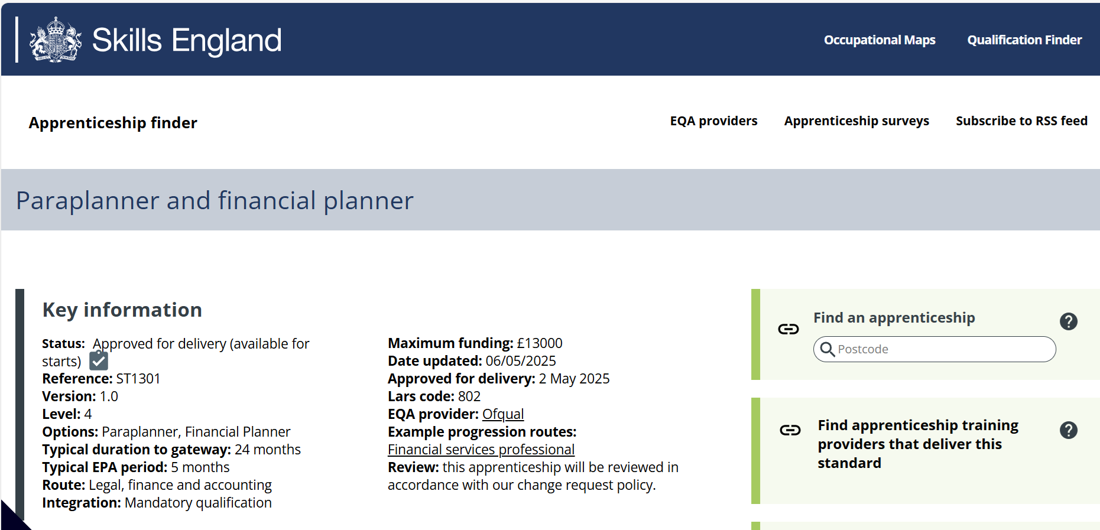
L4 Apprenticeship Standard
Notes:
The L4 Apprenticeship Standard for Paraplanner and Financial Planner, which Jude has just discussed was launched on 26th June and this can now be seen on the Skills England website.
This is the format of what this looks like with all the relevant details.

Slide 23
Financial Services Standards
A Range of Apprenticeship Options
Financial Services Administrator
Level 3
Mortgage Adviser
Level 3
Paraplanner & Financial Planner
Level 4
Financial Services Professional
Level 6
Notes:
However, we also have other Apprenticeship Standards which could be used as part of this Career Pathway.
For example, there is a Level 3 Financial Services Administrator
There is a Level 3 Mortgage Adviser Apprenticeship
There is the Level 4 Paraplanner and Financial Planner, which we have mentioned already.
AND, there is a Level 6 Financial Services Professional – However, it should be mentioned that this is not a Chartered Financial Planner Apprenticeship, which currently doesn’t exist.
All only available in England.

Slide 24
Apprenticeship Training Providers
Offerring L4 Paraplanner & Financial Planner
Davies Learning Solutions Limited
Simply Academy Limited
LIBF Limited
Skills Edge Training Limited
Skillcert Limited
Wiser Academy Limited
Metagedu Apprenticeships Limited
Notes:
So, it is also worth knowing that there are a number of Training Providers listed on the Government’s Apprenticeships Website, stating that are delivering this Level 4 Apprenticeship in Paraplanning and Financial Planning.

Slide 25



Summary
The Benefits, Constraints and Asks…
Additional Resource
Not an Outsourced Solution
Commit to Completion
Subsidised Cost
Doesn’t cover Supervision
Coach, Mentor & Support
Notes:
So, to summarise Apprenticeships as a route to help introduce new talent to the advice sector.
Benefits:
Not a golden nugget but a great option for smaller firms who don’t have the training and development resource themselves
Cost is subsidised by the Government – Employers only pay 5% of the training costs.
Constraints:
This is not a fully outsourced solution – The employer still needs to get involved and provide lots of coaching, mentoring and support
This does not cover the Regulatory Supervision process for advisers and the Journey to Competent Adviser Status. This is something that firms will need further support with.
Asks for Employers:
Commit your apprentices to the full completion of the Apprenticeship – Do not drop out after qualifications have been completed.
Work hard to provide a framework of On-The-Job coaching, mentoring and support.

Slide 26

Find An Apprenticeship
https://www.findapprenticeship.service.gov.uk/
Notes:
For more information, please free to view the details held on the NTA Website, or you could go directly to the GOV.UK Website and find an apprenticeship, where there is lots of additional information available.

Slide 27
Learning Objectives
Understand the strategy of the New Talent Alliance, and why we need to help firms recruit, train, develop, manage and retain talent in their business.
Explore the basic mechanics of Apprenticeships in England and how they are funded.
Learn about some specific updates recently made to Apprenticeships, especially in Financial Advice and Paraplanning.
Explore how Apprenticeships could be used as a training and development pathway for new and existing talent.
Notes:
Here are the learning objectives again:
Understand the strategy of the New Talent Alliance, and why we need to help firms recruit, train, develop, manage and retain talent in their business.
Explore the basic mechanics of Apprenticeships in England and how they are funded.
Learn about some specific updates recently made to Apprenticeships, especially in Financial Advice and Paraplanning.
Explore how Apprenticeships could be used as a training and development pathway for new and existing talent.

Slide 28
^{Any Questions?}
Notes:
Thanks again for attending this webinar.
Natalie, do we have any questions which have come through?

